Slide 1
Weight Controlled Dispenser
CS467 final project
By: Derek Morgan

Slide 2
The plan
“The idea is to build a dispensing system for dry goods, like something I saw in an industrial setting for measuring out powder supplements like creatine. Using the correct amount of ground coffee makes for a better cup and saves money. I want to be able to dispense the ground coffee onto a scale until it reaches a predetermined weight and then programmatically engage a mechanical stop on the dispenser. I want the weight to be easily entered in either standard or metric and the current weight and dispensing weight visible on an LCD. For this project the scale used will need to be accurate between 1-.5 grams.”

Slide 3
Not “Free-Flowing”

Slide 4
”Free-Flowing”

Slide 5
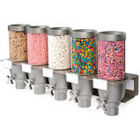
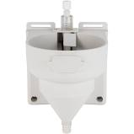
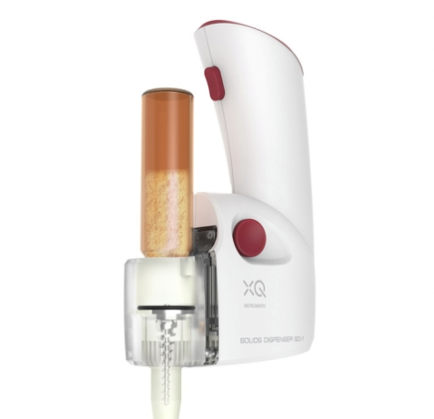
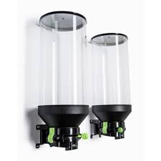
Dispensing?

Slide 6
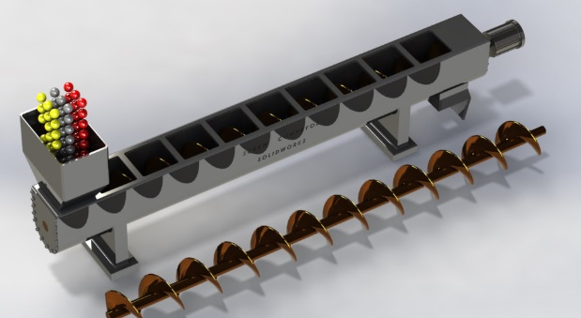
Dispensing?

Slide 7
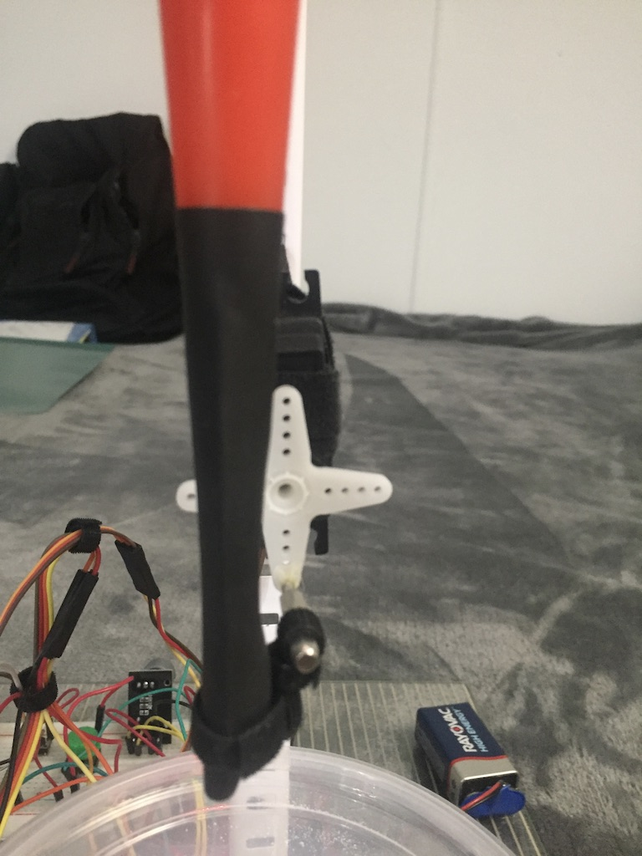
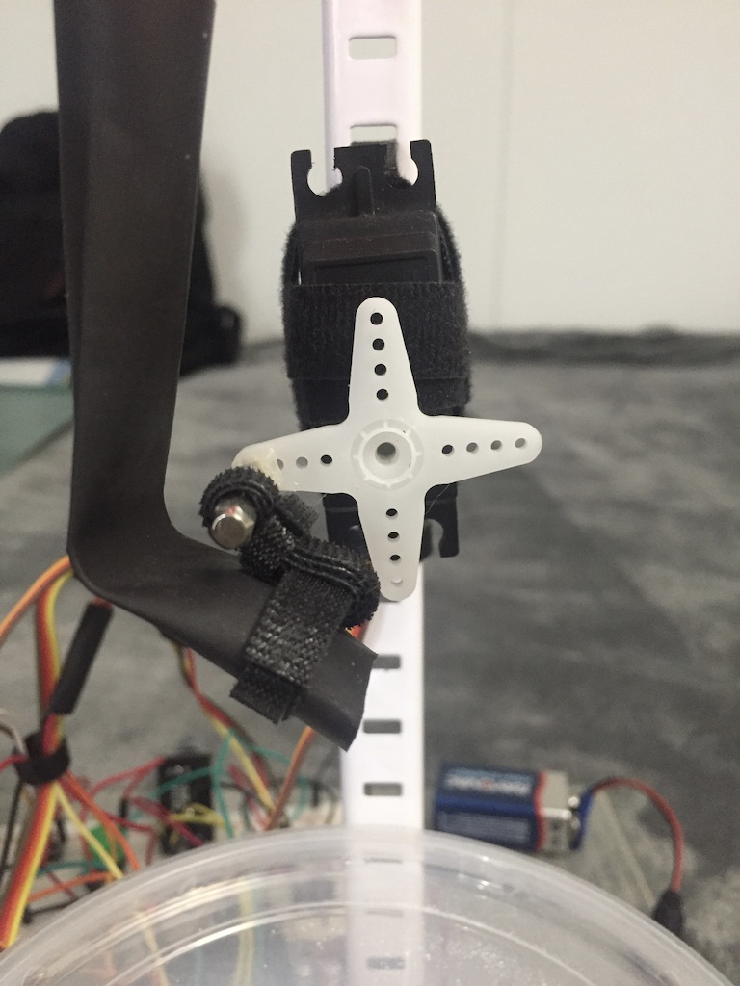
Dispensed!

Slide 8
De-Bounceing

Slide 9
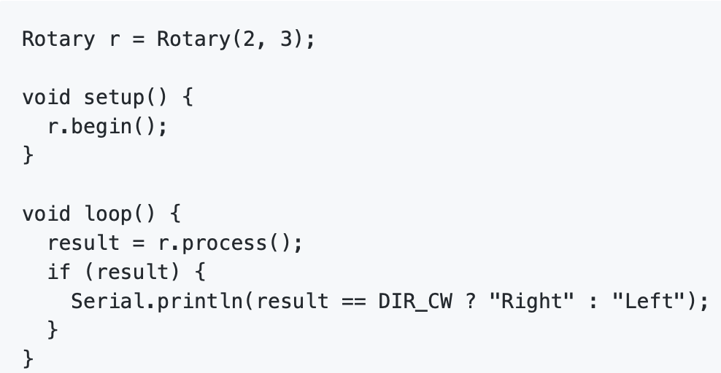
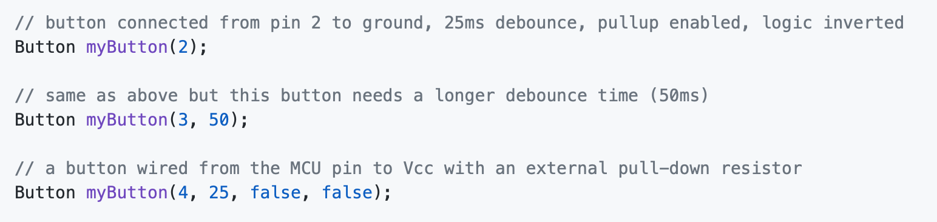
De-Bounced

Slide 10
Scaling Factors

Slide 11
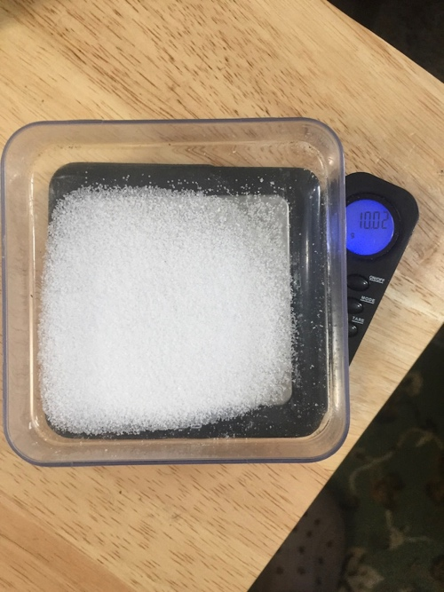
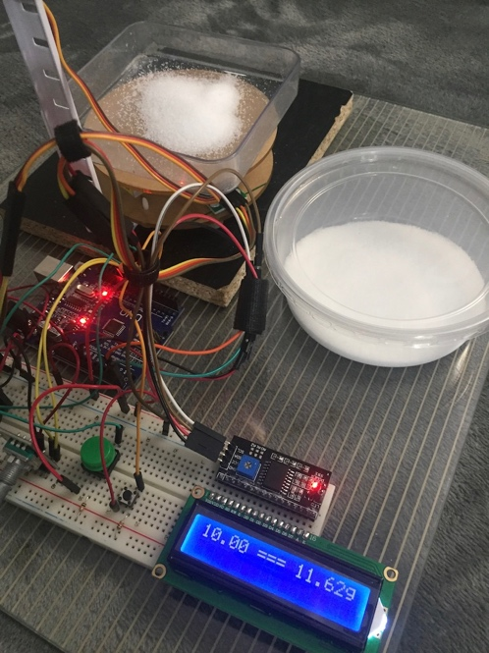
It Weighs’ish

Slide 12
Keywords

